Slide 1
Artificial Intelligence
Project on
WINTER SEMESTER
(VI Int. M.Tech. MnC)
NAME : Ayush Somani
Adm. No. : 16JE001852
Submitted to: Dr. Sanjeev Anand Sahu

Slide 2
What is Artificial Intelligence ?
AI is the study of ideas that enable computers to be intelligent.
AI is the part of computer science concerned with design of computer systems that exhibit human intelligence(From the Concise Oxford Dictionary)

Slide 3
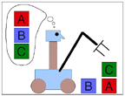
Goals of AI
To make computers more useful by letting them take over dangerous or tedious tasks from human
Understand principles of human intelligence. This would help us to implement human like intelligence with the help of computer systems.

Slide 4
Reasoning and Problem Solving
One of the most important features of human intelligence is reasoning. If we really want to make our systems mimic human intelligence they must be capable of reasoning and problem solving.
The method for doing this is GOAL TREES.
GOAL TREE:- A Goal Tree, sometimes still referred to as Intermediate Objective Map or IO Map, is primarily a Logical Thinking Process tool, itself linked to the Theory of Constraints. The top of the tree deals with strategic planning while going down to its bottom links strategy to operations.

Slide 5
GOAL TREE
The root of the goal tree contains the goal that need to be achieved.
The next level contains the necessary condition to bring about the goal.
Now each next level breaks the complex goal into simpler steps which can be used to fulfill the goal.

Slide 6
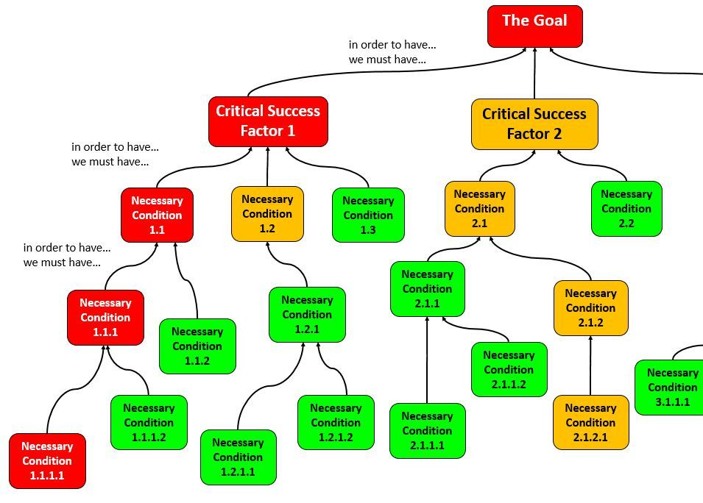
Structure of a goal tree

Slide 7
Rule based expert system
In artificial intelligence, an expert system is a computer system that emulates the decision-making ability of a human expert. Expert systems are designed to solve complex problems by reasoning about knowledge, represented mainly as if–then rules rather than through conventional procedural code.
These mimic human’s decision making abilities based on specific predefined rules.
Notes:
Eg. A system that predicts animals based on given characteristics.

Slide 8
Answering questions about their behavior
We can make a system that can answer questions regarding its behavior using goal trees.

Slide 9
Searching Techniques
The most common searching techniques are Depth-first and Breadth-First Search algorithms.
These help us in finding paths between a source and a goal node.
These are uninformed searches as they do not posses any heuristic information.
These return a path not necessarily the best path.

Slide 10
Informed Search Techniques
Hill Climbing
These searches make use of heuristic information which is the approx distance(not actual) between two nodes.
These are like bfs and dfs except the fact that at each level of the path tree the node with minimum distance to the goal is extended
Beam Search
These searches also make use of heuristic information which is the approx distance(not actual) between two nodes.
Theses have a beam of length w at each level we keep the w best paths and discard the rest.
These w best paths are further extended.
These searches also do not guarantee an optimal path.

Slide 11
Search Technique for optimal path
Branch and Bound
These are uninformed searches.
These do not make use of any heuristic information.
In the state space diagram for this method the leaf node having the minimum accumulated distance is extended.
This method ensures that we get the shortest path because once we reach the goal via some paths the other extensions of the state space diagram are also extended further till either we get the goal state or we get accumulated distance greater than the smallest till encountered.

Slide 12
A* Search
We can combine branch and bound with heuristic information.
This makes the algorithm much more smarter and faster.
This method is called A* search.
This is the fastest search algorithm.

Slide 13
Constraint Satisfaction
These include problems which can be represented as a set of variables that can take values from a certain domain D and a set of constraint C.The solution to such problems is one in which all the variables have a value and also satisfy all the constraints.
Eg.: Map Colouring Problem
Set of variable x:{set of regions on the map}
Domain:{set of clours}
Set of constraints:{colour of neighbouring regions must not be same}

Slide 14
Constraint Satisfaction
These problems are solved using a constraint graph in which the variables are the nodes and the constraints are the edges of the graph.
The benefit of representing these problems as a graph is that it provides a generic solution to all problems which can be listed under this type.
Types of constraints
UNARY: When only one variable is involved in constraint i.e. x=Di where x is some variable and Di belongs to domain.
BINARY: When two variables are involved i.e. X1 != X where X1 and X2 both are variables.
HIGHER ORDER: When number of variables is more than 2. eg. cryptarithmetic

Slide 15
SEARCHES USED
Here the states will be a set containing assignment to each variable. Initially each variable has null assignment.
DFS for CSPs are termed as backtracking search.
The speed of this can be increased by adding heuristic information.

Slide 16
INCREASING SPEED
In this searches at each level a new state is achieved by assigning value to a single variable.
Instead of selecting a variable randomly to be assigned a value we can select it based on following rules:
The variable with the maximum number of constraints or minimum number of remaining values should be assigned first.
In case of a tie select the variable which is the most constraining.
When selecting a value from domain for a variable select the value which constraints the system the least.
Forward Checking: Keep record of legal moves available for unassigned variables and terminate when it becomes zero for some variable.

Slide 17
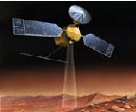
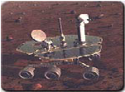
AI Applications
Autonomous Planning & Scheduling:
Autonomous rovers.

Slide 18
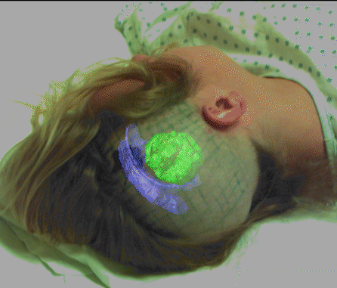

AI Applications
Medicine:
Image guided surgery

Slide 19
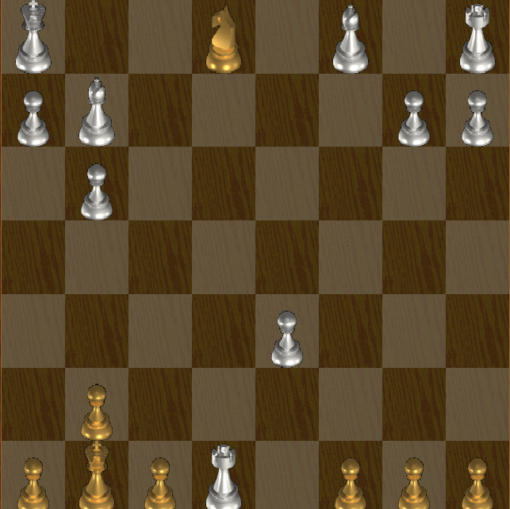
AI Applications
Games:

